Slide 1
Linear Equations
Topic: Solving Equations 2
EQ: How do we use Backtracking to solve equations?
Mrs Stretch
Year 7

Slide 2
Inverse Operation BINGO
Draw a square 3 x 3
Fill it with the 4 operations
  (+, -, ×, ÷)
You may use the operations more than once
Once you have three in a row shout
            BINGO

Slide 3
Inverse of:
÷

Slide 4
Inverse of:
×

Slide 5
Inverse of:
-

Slide 6
Inverse of:
-

Slide 7
Inverse of:
÷

Slide 8
Inverse of:
+

Slide 9
Inverse of:
×

Slide 10
Inverse of:
-

Slide 11
Inverse of:
+

Slide 12
Inverse of:
÷

Slide 13
Inverse of:
+

Slide 14
Inverse of:
×

Slide 15
Inverse of:
÷

Slide 16











24
7
30
Solving Equations
Date
EQ – How do we use Backtracking to solve equations?
Examples
Steps
How do we Backtrack harder equations?
Step 1: Draw the flowchart boxes and the arrows
Step 2: Fill in the top boxes and write the answer in the last bottom box
Step 3: Write the inverse operations on the chart
Step 4: Fill in the boxes following the arrows
$$2(x+5)=14$$
$$+5$$
$$×2$$
$$x$$
$$x+5$$
$$2(x+5)$$
$$2$$
$$7$$
$$14$$
$$−5$$
$$÷2$$

Slide 17










24
7
30
Solving Equations
Date
EQ – How do we use Backtracking to solve equations?
Examples
Steps
How do we Backtrack harder equations?
Step 1: Draw the flowchart boxes and the arrows
Step 2: Fill in the top boxes and write the answer in the last bottom box
Step 3: Write the inverse operations on the chart
Step 4: Fill in the boxes following the arrows
$$\frac{x+8}{2}=9$$
$$+8$$
$$÷2$$
$$x$$
$$x+8$$
$$\frac{x+8}{2}$$
$$10$$
$$18$$
$$9$$
$$−8$$
$$×2$$

Slide 18














24
7
30
Solving Equations
Date
EQ – How do we use Backtracking to solve equations?
How do we Backtrack harder equations?
$$\frac{2x+1}{3}=3$$
$$×2$$
$$+1$$
$$÷3$$
$$x$$
$$2x$$
$$2x+1$$
$$\frac{2x+1}{3}$$
$$4$$
$$8$$
$$9$$
$$3$$
$$÷2$$
$$−1$$
$$×3$$

Slide 19


Slide 20
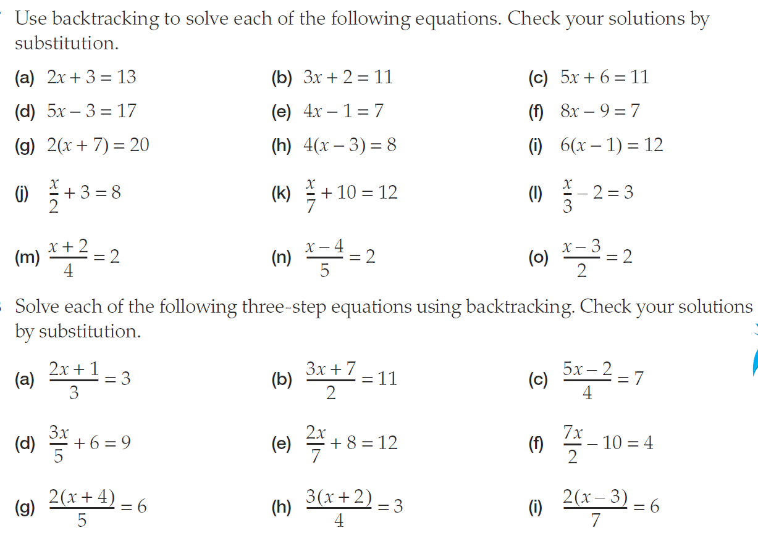
Task

